Slide 1
GRU-Based Predictive Route Optimisation for Emergency Vehicle Navigation
Freshia Njoki PA206/S/25427/24
MSc Computer Science, Kirinyaga University
Notes:
My name is Freshia Njoki Macharia. This thesis is a GRU-based predictive route optimisation framework for emergency vehicle navigation
decision-support framework for emergency-vehicle routing. It forecasts traffic speeds for the next thirty minutes, computes a time-dependent path, and offers a new path only when remaining travel time has truly worsened. This is my second progress presentation therefore ill be forecassing on obj 3 and 4

Slide 2
Statement of the problem
A route that is shortest at dispatch is optimal only for the speeds seen at that moment. If a corridor slows fifteen to thirty minutes later, the vehicle is already committed. That is the failure this study treats.
What dispatch does
A current-map shortest path — Dijkstra, or A* — using speeds available at departure.
Identified research gap
Strong predictors and strong time-dependent routers are usually published apart. An emergency loop that joins a learned forecast, time-dependent search, and a tested remaining-time trigger, inside one second, is missing.
Data and test setting
Public freeway detector archives (METR-LA; PEMS-BAY). Local mixed traffic is the next deployment step.
Notes:
The operational problem is simple. At dispatch we compute a shortest path from the speeds on the map RIGHT NOW. That path is optimal only for those speeds. If a queue forms on the planned road 15 or 30 minutes later, the vehicle is already committed to it.
That is how most computer-aided dispatch still works — Dijkstra, or A-star, on a current snapshot.
THE GAP. The literature has excellent traffic predictors, and strong time-dependent shortest-path algorithms. They usually sit in different papers. Werner and colleagues did combine the two in 2022 — but for general navigation, with pre-processing that assumes edge weights do not change every five minutes.
What is missing is one EMERGENCY loop: learn the next half hour, route on those changing costs, and interrupt the dispatcher only when remaining time has really jumped — all in one second.
On data: I trained my model on public loop-detector using METR-LA & PEMS-BAY data sets so the run can be reproduced.

Slide 3
Purpose and Research Objectives
Purpose
To design and evaluate a dispatcher-support framework that cuts realised emergency-vehicle travel time by joining GRU speed forecasts, time-dependent A*, and a remaining-time threshold.
Obj. 1
Map the gaps among emergency routing, traffic prediction, and time-dependent pathfinding.
Obj. 2
Build the three-part system: GRU predictor, time-dependent A*, remaining-time controller.
Obj. 3
Find which remaining-time threshold δ to use — 5%, 10%, 15%, or 20%.
Obj. 4
Measure realised travel time and latency against four baselines, inside one second.
Notes:
The purpose was to design and evaluate that loop as dispatcher support, not as an autonomous routing agent.
Four objectives. ONE, lit review of existing papers and map the gap. TWO, build the three parts/components of the framework — GRU predictor, time-dependent A-star, remaining-time controller. THREE, find which threshold/delta to use. Delta is a policy, where If remaining time from where the vehicle is now grows by more than delta, we offer a new path.
Four: measures the travel time reduction and evaluate against four baselines.

Slide 4
Integrated Routing Framework
1
2
3
Observe
Forecast
Cost
Last 60 minutes of detector speeds — 12 frames, five minutes each.
Two-layer GRU, 64 units, dropout 0.2. Next 30 minutes — 6 frames.
Predicted miles per hour become travel time on each detector-to-detector edge.
4
5
6
Route
Update
Decide
Time-dependent A* from origin to destination using those changing costs.
If remaining time from the current position grows by more than δ, offer a new path.
The dispatcher accepts or rejects. The vehicle is not self-driving.
Notes:
This is how the model behaves or was built
ONE, We look at the last hour of detector speeds, which is presented as 12 frames, of 5 minutes each.
TWO, A two-layer GRU, with 64 hidden units per layer, dropout 0.2, forecasts the next 30 minutes — which is actually 6 frames.
THREE, Those speeds become the time to cross each road.
FOUR, Time-dependent A* picks a path (by searching the origin to destination). Edge cost depends on when the vehicle would enter that road, not only on now.
FIVE, Update. As the vehicle moves, remaining time is recomputed FROM ITS CURRENT POSITION, not from the station. If that remaining time grows by more than delta, we offer a new path. The observation window slides forward every five minutes, so a jam appearing mid-trip is seen.
SIX, Decide. A person accepts or rejects, since this is Decision Support - the framework recommends, the dispatcher decides.

Slide 5
Experimental Design and Internal Validity
Simulation design (N = 900 journeys)
What I did so the comparison is fair
• METR-LA: 207 detectors, 34,272 five-minute speed frames. This is the routing graph: 207 nodes, 1,515 edges, a measured speed on every edge (100% instrumented).
• PEMS-BAY: 325 detectors, 52,116 frames. A second GRU only — not a second routing city.
• 75 origin–destination pairs × 3 traffic scenarios × 4 values of δ = 900 journeys.
• Scenarios: peak (slowest quartile of test windows), off-peak (fastest quartile), incident (corridor speeds cut to 40% of observed, after 20% of B1 travel time).
• Four baselines: B1 current Dijkstra; B2 historical static A*; B3 reactive A* (one replan once the jam is visible); B4 oracle (actual future speeds).
• Split time 70 / 15 / 15 before windowing. Scaler fitted on training rows only — no leakage from later weeks.
• The forecast chooses the path. Journey time is then walked on actual future speeds. We do not score a method on its own predictions.
• Same origin, destination, and clock for every method. That is what N will mean on the result figures.
• Incidents sit on Dijkstra’s planned corridor, so the vehicle actually meets the disruption.
• I used the fully instrumented detector graph, not a sparse street map with guessed speeds. Percentages describe that graph.
Notes:
This slide presents the test bed behind every result that follows: where the 900 journeys were run, and the rules that stop the framework from flattering itself.
Los Angeles freeway detectors: 207 sensors, 1,515 roads, a measured speed on every road.
900 journeys = 75 routes × 3 traffic conditions × 4 threshold values.
PEAK is the slowest quartile of test windows. OFF-PEAK is the fastest quartile — my negative control; a forecast and a current map ought to agree there. INCIDENT: after twenty percent of the planned Dijkstra time, corridor speeds fall to forty percent of observed. The incident sits on Dijkstra's OWN corridor, so the vehicle actually meets it.
Four baselines: dispatch practice, a typical day, a reactive router allowed one replan once the jam is visible, and an oracle using actual future speeds. WE MUST NOT BEAT THE ORACLE. If we did, the experiment would be broken.
And the honesty of the clock: predicted costs CHOOSE the path; every method is then WALKED on actual future speeds. No method is scored on its own forecast.
> ADVANCE at 6:00.

Slide 6
Objective 2 — GRU forecast accuracy
3.48 mph
2.38 mph
60 → 30 min
METR-LA test MAE
RMSE 6.04 mph · 27 epochs
PEMS-BAY test MAE RMSE 4.49 mph · 79 epochs
Input 12 steps · output 6 steps
matched to a typical response
Interpretation of error
• MAE is mean absolute error: on average the forecast is 3.48 miles per hour off on held-out Los Angeles detectors
• The Bay model is a second-city check of the same architecture. Its lower MAE reflects smoother Bay Area speeds, not a failed Los Angeles model. Bay speeds were never routed on Los Angeles edges.
• This accuracy is sufficient to serve as time-dependent edge cost for TD-A*, and the GRU delivers it at lower parameter count and 39.3 ms inference — keeping the whole loop at ≈40 ms against the 1,000 ms dispatch cap.
Notes:
Objective two. Can a light GRU forecast the next half hour well enough to RANK ROADS?
On Los Angeles: test mean absolute error three point four eight miles per hour, RMSE six point zero four, early stopping at twenty-seven epochs. On the Bay Area, a separate model: two point three eight MAE, RMSE four point four nine, seventy-nine epochs.
on held-out Los Angeles detectors the forecast is on average about three and a half miles per hour off. That is inside the three point one to four point two band already published for comparable GRUs.
The Bay error is lower because those freeways are smoother. Not Los Angeles failing — and I never routed Bay speeds on Los Angeles edges.
A spatial-temporal graph network WOULD beat this MAE. I chose a two-layer GRU deliberately: the loop has to answer inside one second, and the router needs edges RANKED correctly more than predicted perfectly.

Slide 7
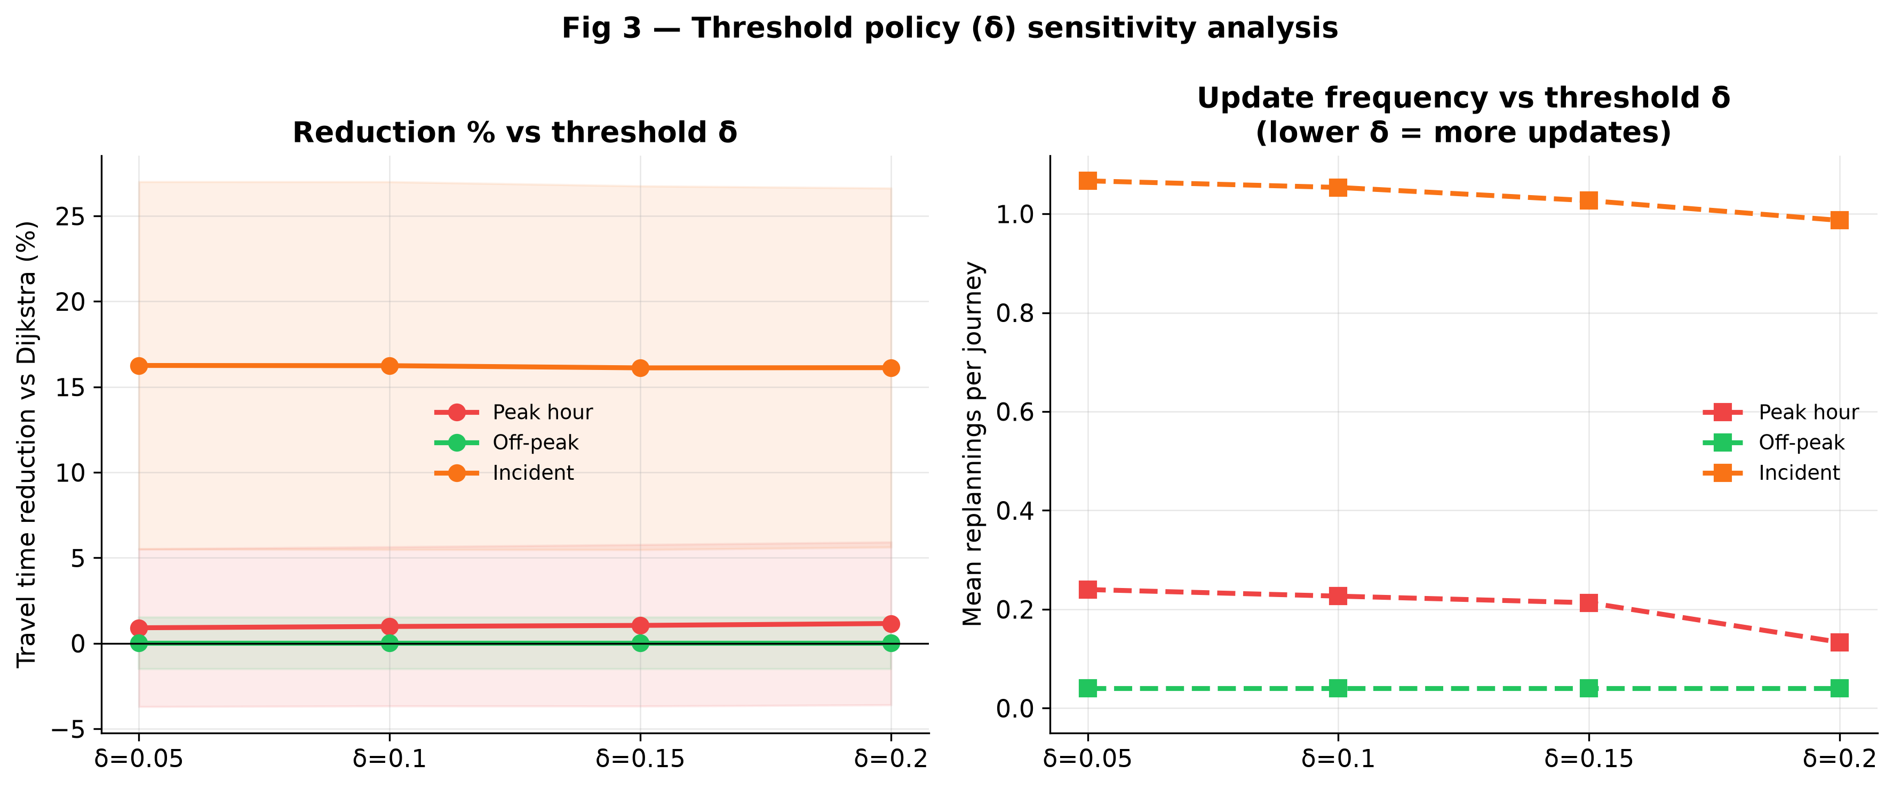
Objective 3: Effect of threshold δ on travel time and replans
Figure 3. Travel-time reduction relative to current-map Dijkstra (left panel) and mean replans per journey (right panel) by remaining-time threshold δ. N = 225 per δ (75 origin–destination pairs × 3 traffic scenarios). ANOVA: F ≈ 0.001, p = 1.00. Recommended operational default: δ = 0.20.
Table 3. Threshold sensitivity: mean reduction versus Dijkstra and replans per journey.
δ | Mean vs Dijkstra | Replans / journey
0.05 | +5.726% | 0.45
0.10 | +5.748% | 0.44
0.15 | +5.726% | 0.43
0.20 | +5.767% | 0.39
Notes:
Objective three. LEFT panel: travel-time reduction versus Dijkstra at each delta. RIGHT panel: replans per journey. Lower delta means more sensitive, so more alerts.
N is 225 per delta — 75 pairs x 3scenarios, pooled.
Looking at the left panel. THE LINE IS FLAT. 5, 10, 15, 20— about five point seven percent every time. ANOVA gives F approximately zero point zero zero one, p equals one point zero zero.
THAT IS NOT A FAILED EXPERIMENT. It means the four policies are interchangeable on travel time. Why? In the incident scenario the corridor drops to forty percent of observed speed, so remaining time jumps well past twenty percent. Even the strictest policy still fires — about one point zero three replans per incident journey at every setting.
When travel time is identical, decision-support theory prefers the QUIETER alert. That is delta zero point two zero: replans fall from zero point four five to zero point three nine.
After training and validation, zero point two zero is the RECOMMENDED DEFAULT.
N = 225. It's the number of simulated journeys

Slide 8
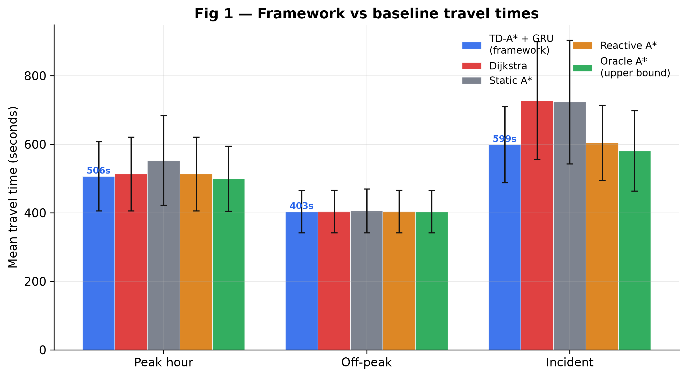
Objective 4 : Mean Journey Time by Traffic Scenario
Summary of main results
INCIDENT — the operational result Dijkstra B1 727.5 s Static A* B2 723.2 s Reactive A* B3 603.7 s Framework 598.9 s Oracle B4 580.5 s PEAK — small but significant Dijkstra B1 513.1 s Framework 506.3 s OFF-PEAK — negative control All methods ~403.4 s Framework stays above the oracle (-1.69% overall). That is what an honest ceiling looks like.
Figure: mean travel time (seconds). Same 75 pairs and clock for every method. Incident, peak, and off-peak are separate groups.
Notes:
These bars are mean journey time in seconds — clock time from origin to destination, after every method is driven on the real future speeds.
Start with the INCIDENT cluster. Dijkstra averages seven hundred and twenty-seven point five seconds. The framework averages 599 seconds. That is about two minutes and ten seconds saved on that test graph when the planned road is disrupted. Reactive A-star, which replans once the jam is already on the snapshot, is 604 seconds — close to us. The framework remains below the oracle (−1.69% overall), as required for a valid upper bound. Since oracle knows the actual future speeds. Our system only has a forecast. Sitting a little behind the oracle
TWO THINGS TO NOTICE.
reactive A-star is close. Once the slowdown is visible in current speeds, a thirty-minute forecast adds little. The value of the GRU is anticipatory: it can divert before the vehicle is fully committed. That is the keen reading of this figure. We are not claiming to dominate a reactive router after the jam is obvious.
Peak. Both methods are around 510 seconds. A small real gap — the network is busy in every direction.
Off-peak. Every serious method sits near 403 seconds. Empty roads are the control. A forecast and a current map should agree. They do. That is success.

Slide 9
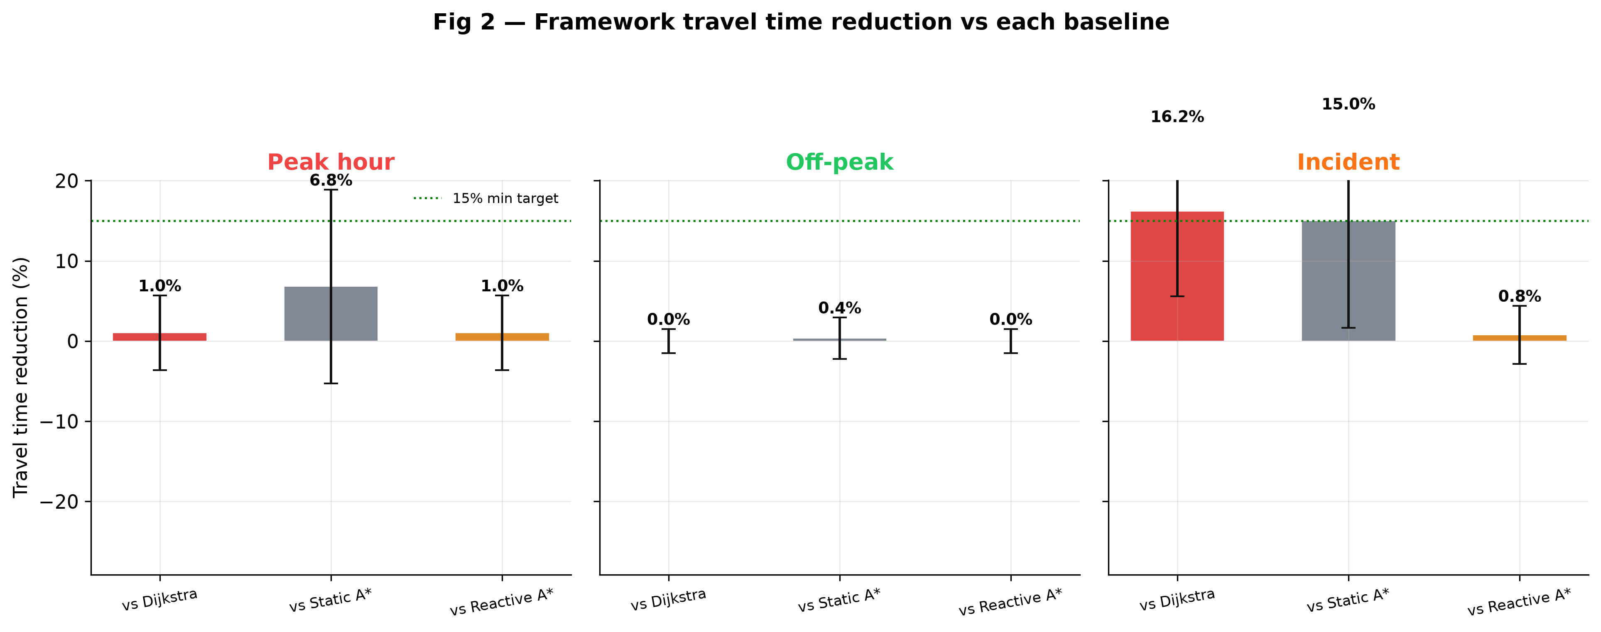
Objective 4: Percentage reduction versus baseline B1
Figure: mean % reduction versus Dijkstra. N = 300 per traffic scenario (75 pairs × 4 values of δ). Positive = faster than current-map dispatch.
Statistical summary
Traffic scenario | vs B1 | Significance
Incident | +16.19% | t = 26.43, p < .001
Peak hour | +1.03% | t = 3.81, p = .0002
Off-peak | +0.01% | t = 0.12, p = .90 (n.s.)
Overall: versus Dijkstra +5.74% versus historical A* +7.39% versus reactive A* +0.61% versus oracle −1.69%
Notes:
This is the same experiment, now as a percentage against Dijkstra. N equals three hundred per scenario — seventy-five pairs times four deltas values. We can pool delta because Objective 3 showed travel time does not depend on which of the four policies we pick. Three hundred is one traffic scenario.
Percentage reduction: how much shorter the framework journey is than Dijkstra’s, on the same origin, destination, and clock. Positive means we were faster.
Incident: plus 16.19 percent. t is 26.43, p less than .001. About one replan per journey. That is the result that matches the purpose: when the planned corridor breaks, looking thirty minutes ahead and triggering on remaining time cuts realised delay.
Peak: plus 1.03 percent. Statistically detectable, p equals .0002. Operationally small. The network is busy in every direction.
Off-peak: plus 0.01 percent, p equals .90. Not significant. The negative control held.
overal I have achieved +5.74% on the MIXTURE of three regimes

Slide 10
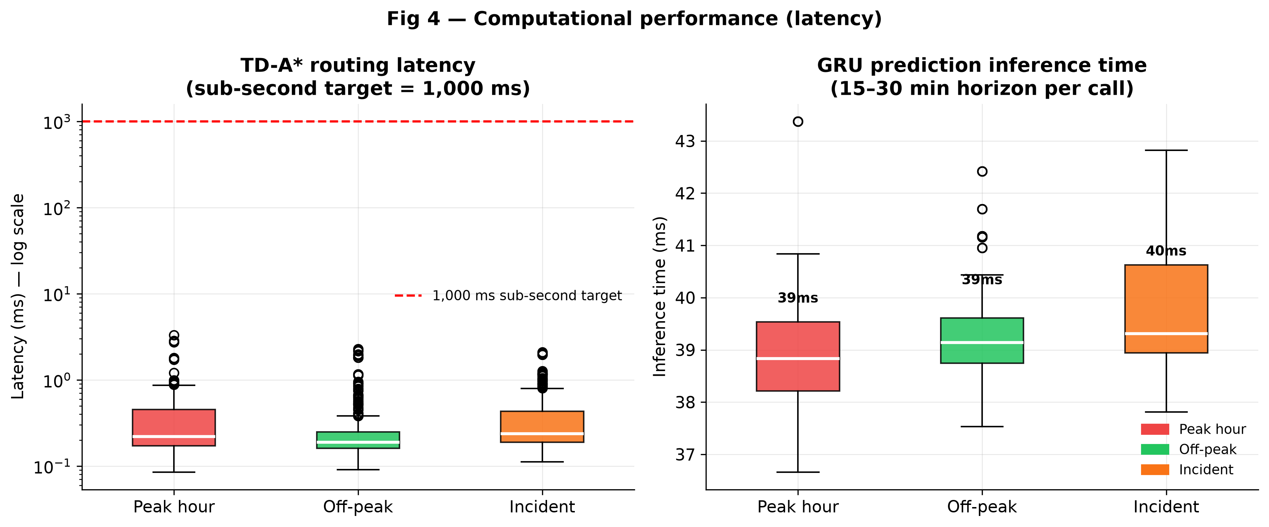
Objective 4 — Computational Latency Analysis
Figure: time-dependent A* search time and GRU inference time. Target is 1,000 milliseconds.
Measured response time
Time-dependent A* 0.37 ms GRU inference 39.3 ms Combined system response ≈ 40 ms One-second response limit 1,000 ms
Notes:
This figure is not travel time — it is compute time, it shows how long each module takes to run.
Left: time-dependent A-star search averages 0.37 milliseconds, well under one millisecond in every scenario,
Right: GRU inference, about 39.3 millisecondsCombined, about 40 milliseconds, roughly twenty-five times inside the one-thousand-millisecond dispatch budget.
Note which module is the slower one: THE PREDICTOR, NOT THE ROUTER. Incident, peak, and off-peak all look the same — the loop meets the one-second (1000 milliseconds ) which is the operational limit — for the system to return a route recommendation after a dispatcher request.
> ADVANCE at 12:25.

Slide 11
Study Limitations and Mitigations
Scope limitations
Validity controls applied in this study
• METR-LA and PEMS-BAY are United States freeway detectors. They are not Nairobi mixed traffic.
• The 900 journeys used 100% detector coverage. The percentages describe that graph.
• A 10–30% coverage run, as a sparse-sensor analogue, was not executed.
• One vehicle. Multi-unit interference was not modelled.
• Did not invent speeds on unmapped streets: routed only on fully instrumented detector links.
• Did not leak the future into training: chronological split; scaler on train only.
• Did not mark paths with predicted time: scored every method on actual future speeds.
• Did not compare only with weak dispatch: included reactive A* and an oracle.
• Did not assume delta: swept 5–20% and let travel time decide.
Notes:
These percentages describe Los Angeles & Bay areaFREEWAY detectors with a sensor on every edge. Transfer to a mixed-traffic city like Nairobi needs local sensors They are not mixed traffic — and here is what I already did about it.
I did not route on a sparse street map and fill missing roads with guessed free-flow. I used the detector graph so every edge had a measured speed. I also downsample that same graph to 10-30% percent coverage and repeat the nine hundred journeys
I did NOT let the future leak into training: chronological split, scaler fitted on training rows only.
I did NOT score any method on its own forecast — all five walked the actual future speeds.
I did NOT compare against a weak baseline alone: The small gap to reactive, and the small gap behind the oracle, are part of the result.

Slide 12
Summary of Principal Findings
1
Under incidents, mean time falls from 727.5 s to 598.9 s versus current-map Dijkstra — 16.19%, about one replan.
2
Travel time does not depend on which δ in 5–20% we pick. The operational default is 0.20: same time, quieter alerts.
3
Combined latency is about 40 ms. The binding constraint for deployment is local sensor coverage, not compute.
Notes:
[13:40 – 14:15 · 35 sec]
Three findings.
ONE. Under incident conditions the framework cut current-map Dijkstra time by 16.19 percent — about 599 seconds versus 728 — with about one replan per journey.
TWO. Delta from 5 to 20 percent did not change travel time. I recommend 0.20 with quieter/less noisy or disrupting alerts.
THREE. Combined system latency is about 40 milliseconds. The binding constraint on deployment is SENSOR COVERAGE, NOT COMPUTE.

Slide 13
Conclusions and Recommendations
Conclusions mapped to the objectives
Recommendations and further research
• Obj 1 — The prediction and time-dependent search gap was confirmed, and needed emergency loop with a tested remaining-time trigger inside a one-second budget.
• Obj 2 — The three components integrate and run in ≈40 ms on the 207-node, 1,515-edge detector graph. GRU test MAE 3.48 mph (METR-LA), 2.38 mph (PEMS-BAY).
• Obj 3 — Route quality is statistically equivalent across δ ∈ {5, 10, 15, 20}% (F ≈ 0.001, p = 1.00). δ = 0.20 is the measured operational default.
• Obj 4 — The reduction versus Dijkstra is regime-specific: +16.19% incident, +1.03% peak, +0.01% off-peak; −1.69% versus the oracle ceiling.
• Deploy where detectors already exist. At 40 ms against a 1,000 ms budget, compute is not the constraint — sensor coverage is.
• Nairobi Metropolitan Services and KeNHA should build METR-LA-compatible speed archives; NACOSTI should lead a national ITS data-sharing strategy.
• Then: multi-vehicle coordination, live feed integration, and field validation with Nairobi dispatch operators.
Notes:
[14:15 – 15:00 · 45 sec] — CLOSE FIRMLY, THEN STOP TALKING.
To conclude, against the objectives. The gap was confirmed, and closed by construction. The three components ran together inside the one-second budget. Delta zero point two zero is the MEASURED operational default, not the planned one. And the reduction is dispatch traffic scenario-specific — large under incidents, small in peak, smaller in off-peak, and always below the oracle.
My recommendations: adopt delta zero point two zero; invest in detector coverage before compute; and apply the experiment to a downsampled graph that simulates a sparse-sensor network in Nairobi.
Thank you. I welcome your questions.
════════════════════════════════════════════
Q&A CRIB SHEET — answer in one of these frames
════════════════════════════════════════════
WHAT DOES N MEAN? 900 is the whole study. 225 is one delta across three scenarios. 300 is one scenario across four deltas.
WHY NOT NAIROBI DATA? I needed a public, fully instrumented archive so the 900-run can be reproduced. The METHOD transfers; these PERCENTAGES do not, until local detectors exist. That is why the next experiment downsamples this graph rather than guessing Nairobi speeds.
WHY SO CLOSE TO REACTIVE A*? Once the jam is on the snapshot, a 30-minute forecast adds little. The gain is BEFORE that moment. The 0.61% margin is the residual value of the horizon, and I report it rather than hide it.
WHY p = 1.00 ON DELTA? The four policies are interchangeable ON TRAVEL TIME. F ≈ 0.001 is the ratio of between-policy variance to residual variance — near zero because the group means coincide. It is not evidence the controller never replanned; incident journeys averaged 1.03 replans.
WHY IS OFF-PEAK ZERO? That was the negative control. Empty roads should not need a forecast. A non-zero result there would have suggested an artefact.
WHY GRU AND NOT A GRAPH NETWORK? A GNN would lower MAE. The requirement was a sub-second loop, and the router needs correct RANKING of edges more than perfect speeds. Jeong et al. (2021) support GRU parity with LSTM at lower cost. A GNN variant is stated as further work.
DID YOU BEAT THE ORACLE? No — 1.69% slower. Required. Beating it would indicate leakage or a scoring error.
WHY IMPUTE ZEROS WITH THE SENSOR MEAN? It is a stated limitation. A dropped detector is not a stationary vehicle, and mean-fill flattens genuine congestion. Masked loss is the improvement I would make next.
IS THIS FIFO-SAFE? Yes — predicted edge times are clipped to a one-second minimum, which enforces FIFO and keeps the haversine heuristic admissible.
CODE AND FIGURES: github.com/Freshia-Njoki/Emergency_Routing. Every table in Chapters 4 and 5 traces to results/full_report.txt.

